Slide 1
Animal Shelter Outcomes
Presented by Alex Bruny, Liz Beaver, Andres Hoyos Marin, and Nathan Thompson
To the 6pm Predictive analytics section on May 29, 2018

Slide 2
Overview
Motivation
Research Questions
Data
Predictive and Descriptive Analyses
Business Implications
Questions
Notes:
Nafan

Slide 3
Motivation
Reduce Euthanizations
Increase Adoptions
Predict outcome of animal received
Category of outcome
Length of time in shelter
Predict resource load on shelters
Seasonality for animal intakes and outcomes
Number of animals in shelter for given time
Notes:
Alex
Animal shelters take in over 6 million animals annually while there are typically only 3 million adoptions

Slide 4
Research Questions
Which animals are hardest to adopt out? Which are the easiest?
What is the probability of an animal being adopted or euthanized?
How long will an animal stay in the shelter?
What is its most likely outcome for an animal arriving in the shelter?
Is there seasonality for intakes and adoptions?
How many of each type of outcome will occur in a given month?
How many animals can a shelter expect to have in a given month? How is this number changing over time?
Notes:
Andres

Slide 5
Importance
Previous research found strong trends for most research questions
Most famous examples are Black Cat Syndrome and pit bulls
Trends for adoptions are constantly changing
Breeds and colors fall in and out of “style”
Conduct resource load analysis for specific shelter
Shelters are often understaffed and lack analytics capabilities
Many volunteers are short term or seasonal
Analysis can be applied to other shelters if successfully implemented
Notes:
Liz
Shelters have started doing black cat days in response to black cat syndrome, raising adoption rates and putting black cats in vogue

Slide 6
Data
Austin Animal Shelter Intakes and Outcomes
90,000 animals
2011 through 2017
Notes:
ALEX

Slide 7
Data Overview – Raw Data
Animal Characteristics
Breed
Color
Age upon Outcome
Sex
ID
Name
Intake and Outcome Information
Intake Date
Intake Conditions
Intake Type
Outcome Type and Subtype
Outcome Date

Slide 8
Data Overview – Calculated Fields
Animal Specific
Spayed/Neutered
Time in Shelter (days)
Type of Outcome Binary
Outcome Month and Year
Shelter Data
Number of animals in shelter
Outcome Types per month
Total Outcomes per Month

Slide 9
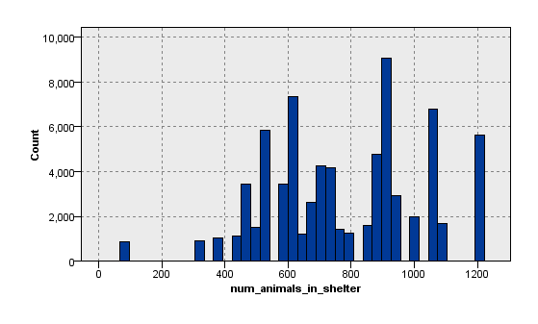
Number of Animals in Shelter
Notes:
Frequency of the number of animals in the shelter for any given month, the low one is the last month (less data)

Slide 10
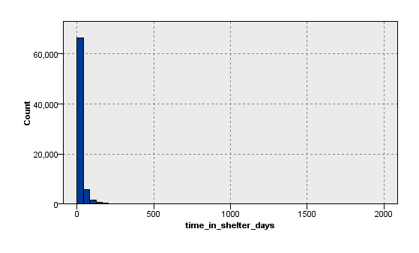
Time in Shelter (Days)

Slide 11
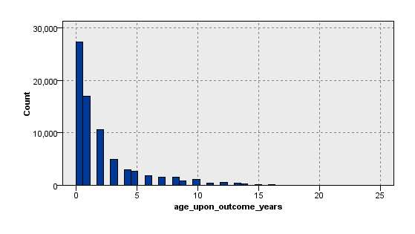
Age Upon Outcome (Years)

Slide 12
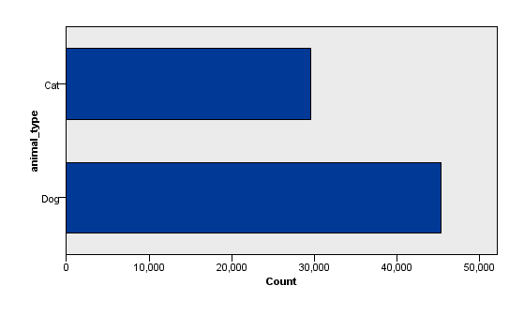
Animal Type

Slide 13
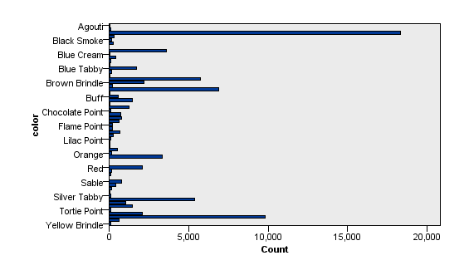
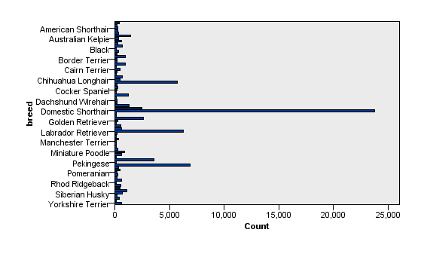
Breeds and Color
Notes:
We used 77 breeds since that included manx and 90% of data and only single color
Very uneven distributions likely made for bad results, if shelters could refine this by type/subtypes it might help analysis

Slide 14
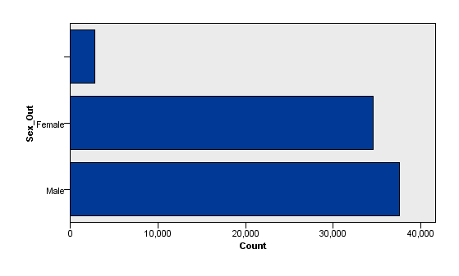
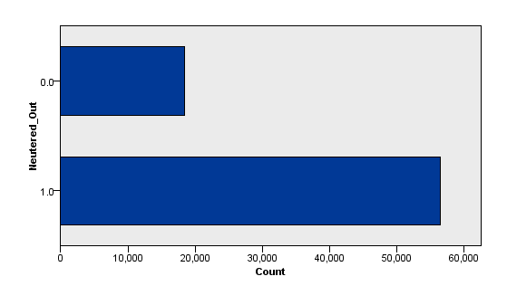
Animal Sex on Outcome

Slide 15
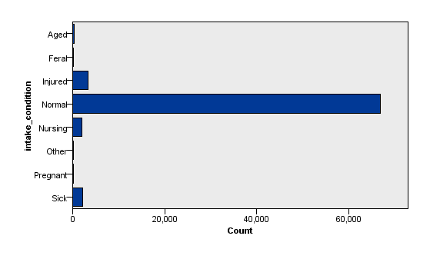
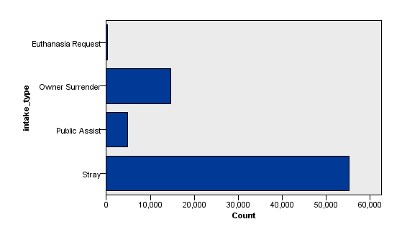
Intake Type and Condition

Slide 16
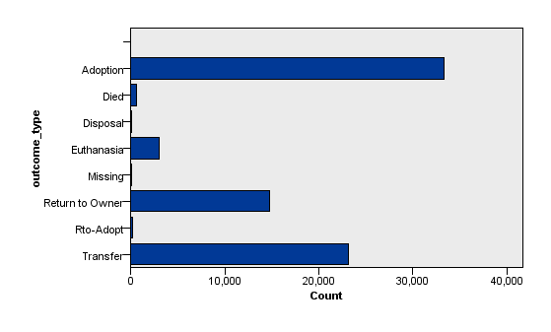
Outcome Types

Slide 17
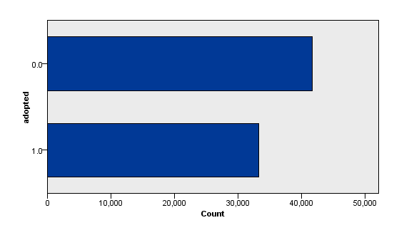
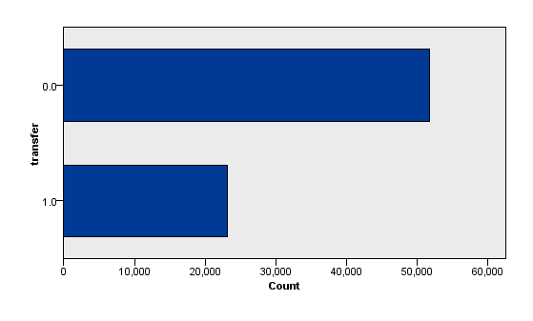
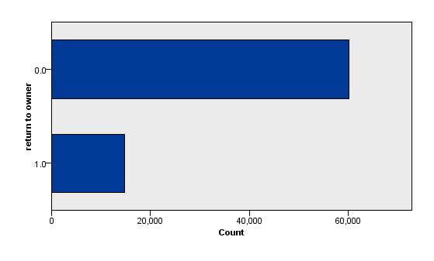
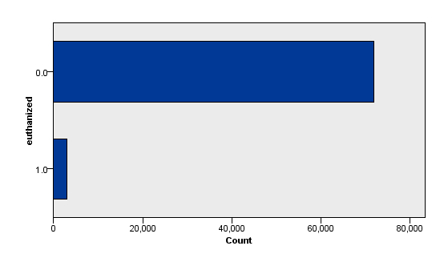
Outcome Types Comparison
Notes:
Alex Done
These are the binary distributions for each outcome type, adopted, transfer, return to owner, and euthanized

Slide 18
Analysis

Slide 19
Association Rules
What outcome trends are evident in the data?
Notes:
Naffan

Slide 20
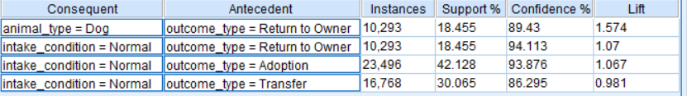
Association Rules
What outcome trends are evident in the data?
Dogs are likely returned to owner
Encourage microchipping to speed process
Alerts for missing animals spread through all nearby shelters
Animals under normal intake conditions are not typically euthanized
Good for shelter PR
Notes:
Side question to get look at overall trends. Very confident for dogs returned to owner. This is still important since dogs take up a lot of resources, so we want to return to owner as fast as possible. Beware of PETA, they love to eat tasty animals. Not Normal intake conditions include sick, injured, pregnant, etc.

Slide 21
Linear Regression
How long will an animal stay in the shelter?
Notes:
Also Naffan

Slide 22
Linear Regression – Preliminary Analysis
Significance at α = 0.10
Breed was only significant for select breeds, removed from model
Warrants further analysis based on common breeds
Color was not significant
Month for intake and outcome were all significant, not shown in model
Later analyses focus on seasonality trends

Slide 23
Linear Regression – Model Output
How long will an animal stay in the shelter?
Notes:
Time to support non neutered old black male pitbull day

Slide 24
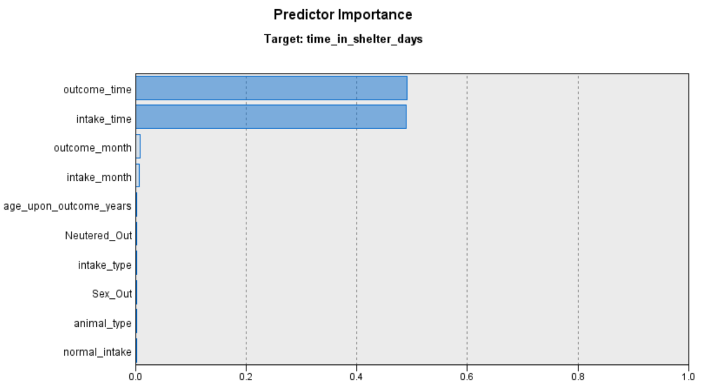
Linear Regression
How long will an animal stay in the shelter?
Notes:
Time to support non neutered old black male pitbull day. When they were taken in is very important to when they are adopted

Slide 25
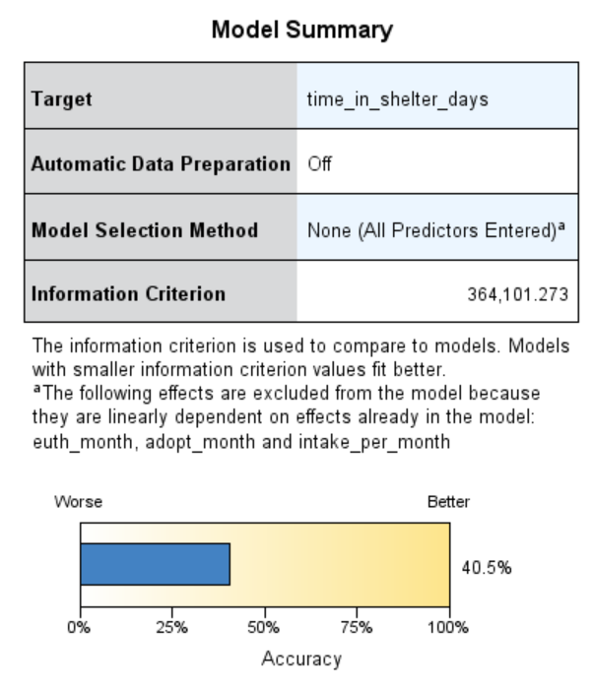
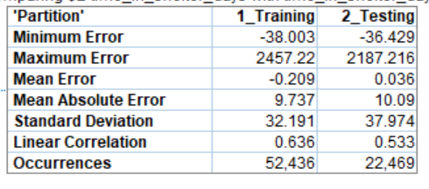
Linear Regression – Model Evaluation
How long will an animal stay in the shelter?
Notes:
Time to support non neutered old black male pitbull day. Model was very good not subject to overfitting had R squared of 0.4 which is stupid high for

Slide 26
Linear Regression – Conclusions
Model was sufficiently accurate at R² of 0.4
Many external factors for adoptions can’t be accounted for
Significant seasonality trend
Older animals are harder to adopt out
Cats take longer than dogs on average
Neutered/Spayed animals take less time to get adopted
Owner Surrenders take more time to adopt out than other intake conditions

Slide 27
Logistic Regression
What is the probability that an arriving animal is euthanized?
What is the probability that an arriving animal is adopted?
Notes:
Andres

Slide 28
Logistic Regression – Preliminary Analysis
What is the probability than an animal will be euthanized?
Significance at α = 0.10
Breed, color and type of animal not significant
Intake type significant predictor

Slide 29
Logistic Regression – Model Output
What is the probability that an animal is euthanized?
Notes:
MEOW MEOW MEOW MEOW
MEOW MEOW MEOW MEOW
MEOW MEOW MEOW MEOW MEOW MEOW MEOW MEOW

Slide 30
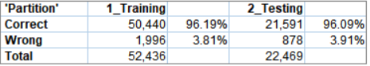
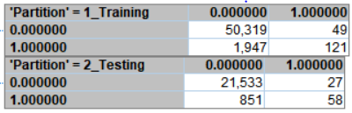
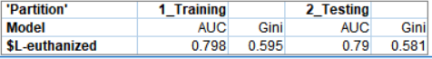
Logistic Regression – Model Evaluation
What is the probability that an animal is euthanized?
Notes:
meow

Slide 31
Logistic Regression – Conclusions
What is the probability that an animal is euthanized?
Model slightly prone to false negatives, under-predicts euthanizations
Females less likely to be euthanized
Sick animals very likely to be euthanized
Owner surrenders more likely to be euthanized than baseline
Notes:
Pretty good model considering what we’re evaluating

Slide 32
Logistic Regression – Preliminary Analysis
What is the probability than an animal will be adopted?
Significance at α = 0.10
Breed and Color are not significant overall
Certain breeds were significant, should pursue additional analysis
Intake condition had one non-significant category, “injured”
Likely dependent on severity of injury which is not accounted for
Notes:
time to support blind old fat black male pitbull with no legs day?

Slide 33
Logistic Regression – Model Output
What is the probability that an animal is adopted?
Notes:
Same thing, we need the actual model. These are model stats for adopted logistic

Slide 34
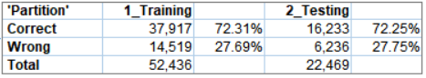
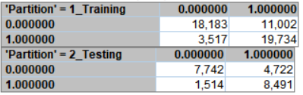
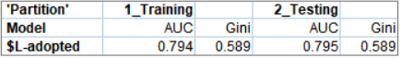
Logistic Regression – Model Evaluation
What is the probability that an animal is adopted?
Notes:
Pretty good model considering what we’re evaluating

Slide 35
Logistic Regression – Conclusions
What is the probability that an animal is adopted?
Significance at α = 0.10
Model prone to false positives but fairly accurate at 70%
Many “adoptable” animals are transferred instead
Not neutered/spayed less likely to be adopted
Cats and females more likely to be adopted
Notes:
Pretty good model considering what we’re evaluating

Slide 36
Decision Tree
What is the most likely outcome for an animal arriving in the shelter?
Notes:
Andres

Slide 37
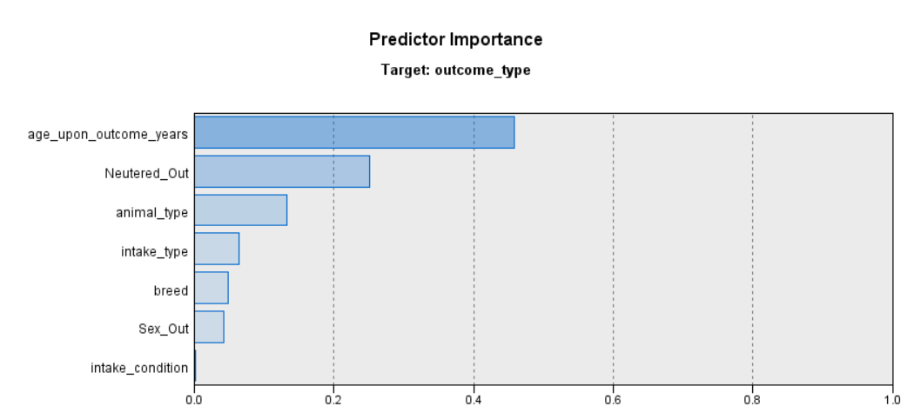
Decision Tree – Important Predictors
What is the most likely outcome for an animal arriving in the shelter?
Notes:
I have no idea what is going on for the graph on the right, please add results :v

Slide 38
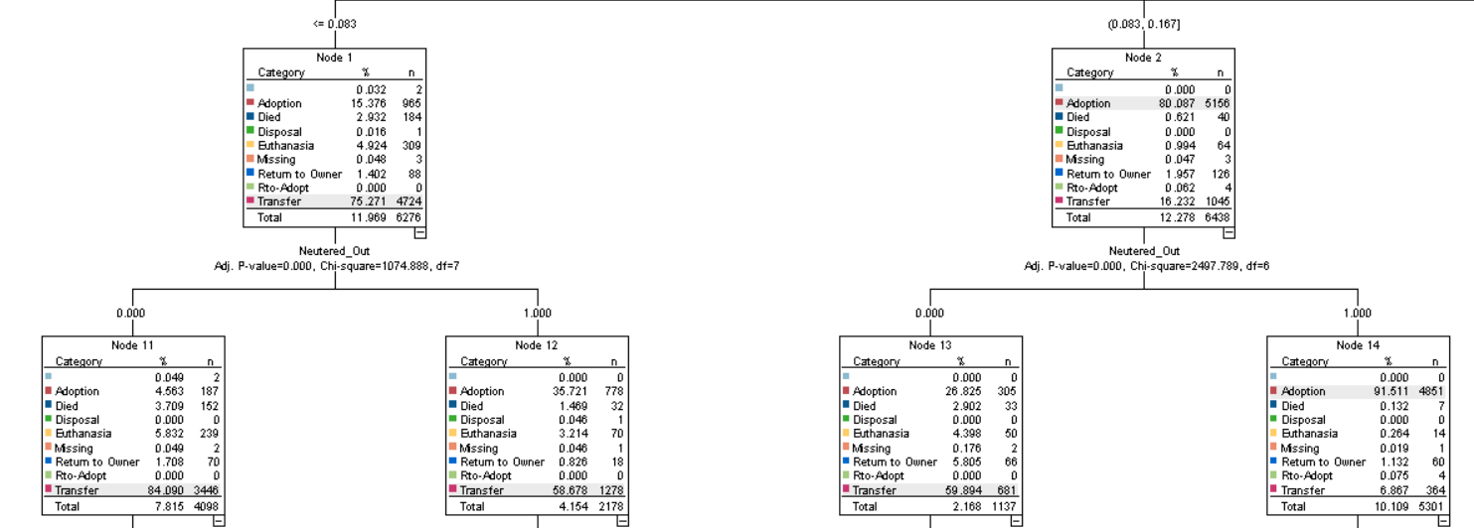
Decision Tree – Model Output
What is the most likely outcome for an animal arriving in the shelter?
Notes:
Example of branch since the model was 5 layers deep with a buttfuck ton of terminal nodes (43)

Slide 39
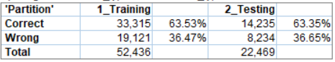
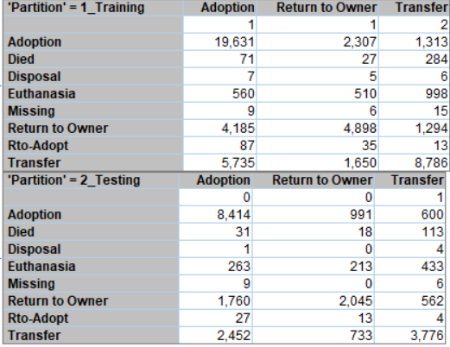
Decision Tree – Model Evaluation
What is the most likely outcome for an animal arriving in the shelter?
Notes:
Not fantastic but also not bad. Model tends to predict adoptions better than other outcomes

Slide 40
Linear Regression
Is there seasonality for intakes and adoptions?
How many animals will a shelter intake in a given month?
How many of each type of outcome will occur in a given month?
How many animals can a shelter expect to have in a given month? How is this number changing over time?
Notes:
Riz

Slide 41
Linear Regression – Preliminary Analysis
Is there seasonality for intakes and outcomes?
ANOVA
Notes:
yes there is seasonality look at that beautiful p-value

Slide 42
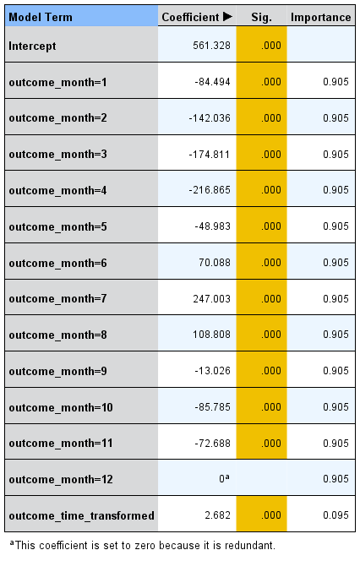
Linear Regression – Model Output
Is there seasonality for adoptions?
Notes:
all significant, a lot of seasonality. Way fewer animals January – March, picks up in April, reallllly bad May through September, lessens a bit in last quarter. Overall will have fewer animals in shelter over the years

Slide 43
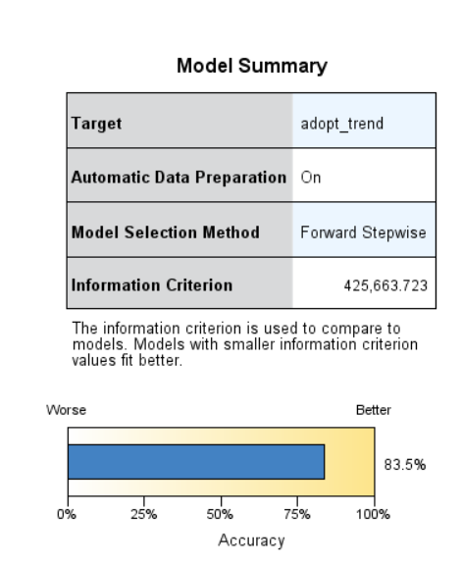
Linear Regression – Model Evaluation
Is there seasonality for adoptions?
Notes:
Adoption seasonal test summary, very high R square at 0.8

Slide 44
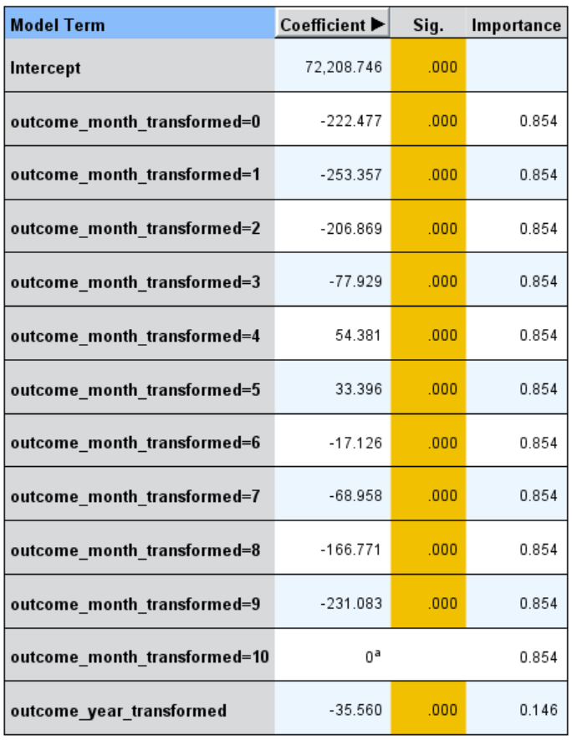
Linear Regression – Model Output
Is there seasonality for transfers?
Notes:
Transfers are important sine we need to let other shelters know when to expect more animals. Transfers are more common slightly earlier in the year, April May instead of May through August

Slide 45
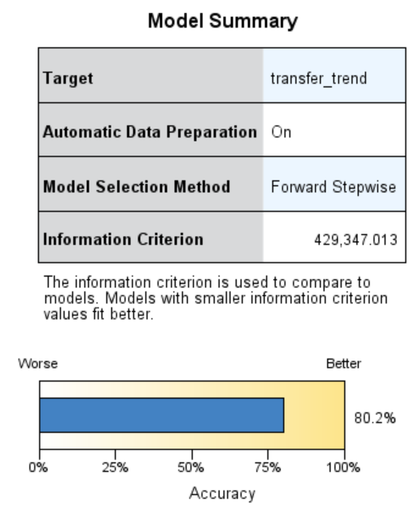
Linear Regression
Is there seasonality for transfers?
Notes:
Transfers evaluation, pretty good model again

Slide 46
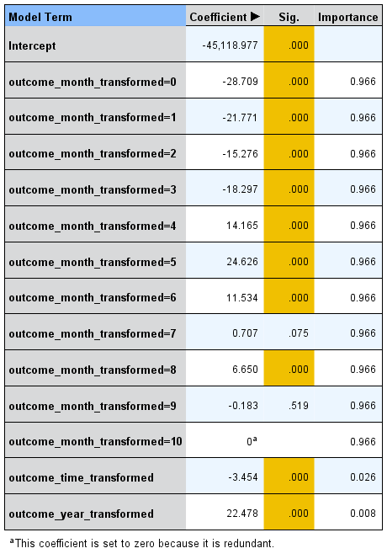
Linear Regression – Model Output
Is there seasonality for euthanizations?
Notes:
mostly significant, need more euthanizations meds May through July, more vets on call etc.

Slide 47
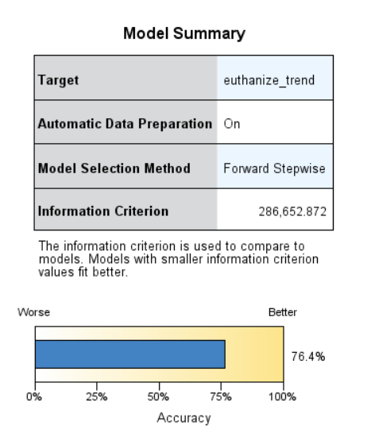
Linear Regression
Is there seasonality for euthanizations?
Notes:
model slightly less good at predicting, likely due to that insignificant month (Sept), only at 76.4 R square

Slide 48
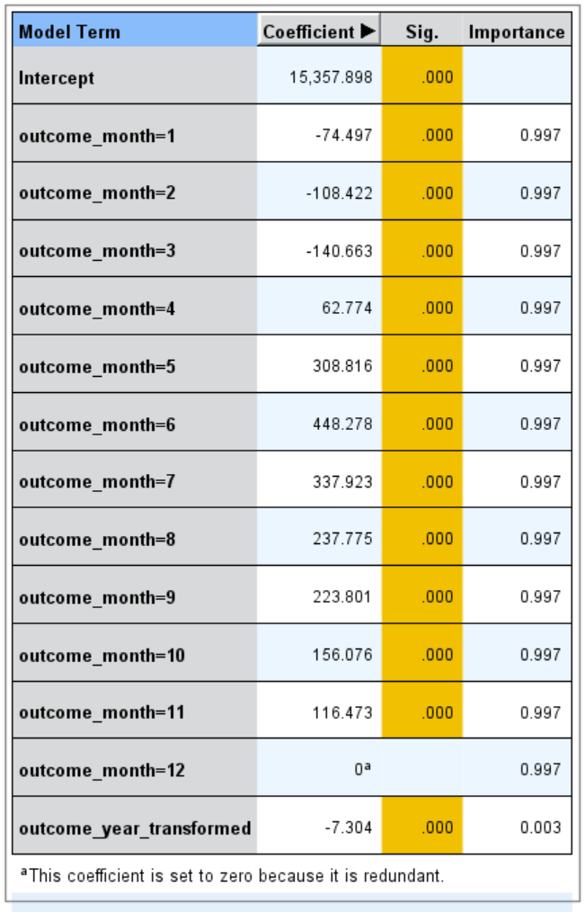
Linear Regression – Model Output
How many animals can we expect to have in the shelter at any month?
Notes:
Response was calculated field number of animals in shelter for that month, number of total intakes – total outcomes since beginning of dataset. Doesn’t account for initial number of animals but we’re looking for a trend. Animals decrease over the years.

Slide 49
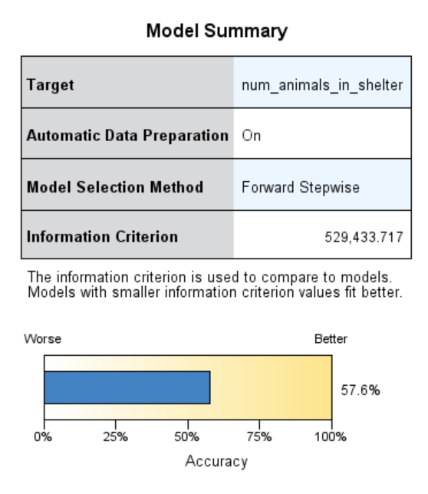
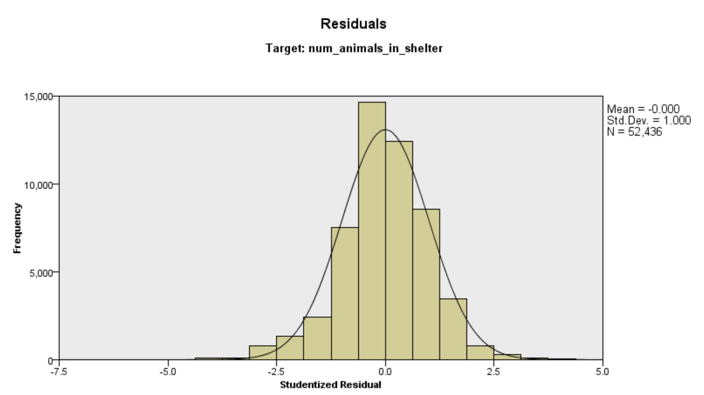
Linear Regression – Model Evaluation
How many animals can we expect to have in the shelter at any month?
Notes:
definitely want to show assumptions held. Model is good overall and can help shelter with seasonality issues

Slide 50
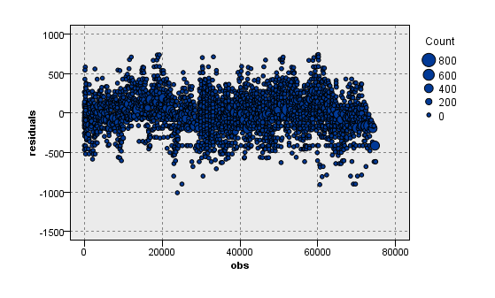
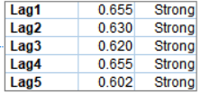
Linear Regression – Model Evaluation
How many animals can we expect to have in the shelter at any month?
Notes:
definitely want to show assumptions held. Model is good overall and can help shelter with seasonality issues

Slide 51
Other Analyses Used
Neural Networks
Had strong results but not worth presenting
K-NN
Every Predictor was important
Low accuracy and very overfit
Notes:
Riz

Slide 52
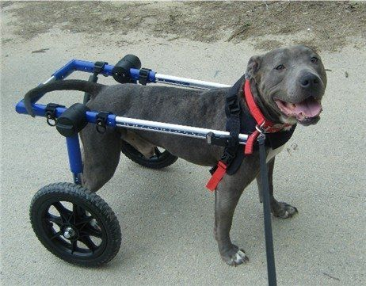
Impactful Findings
Support old, fat, injured, non-neutered, black, male pit bull day
Strong seasonality trends
Campaign for donations during summer
Try to snag students for summer volunteers
Order euthanizations medication in bulk for summer
Notes:
Alex
Business Implications of note/importance

Slide 53
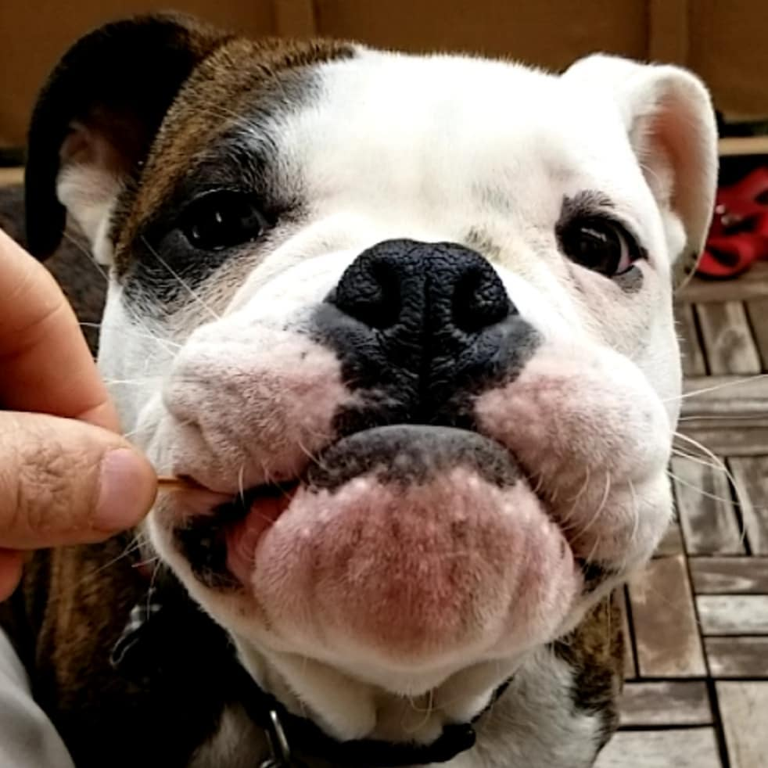

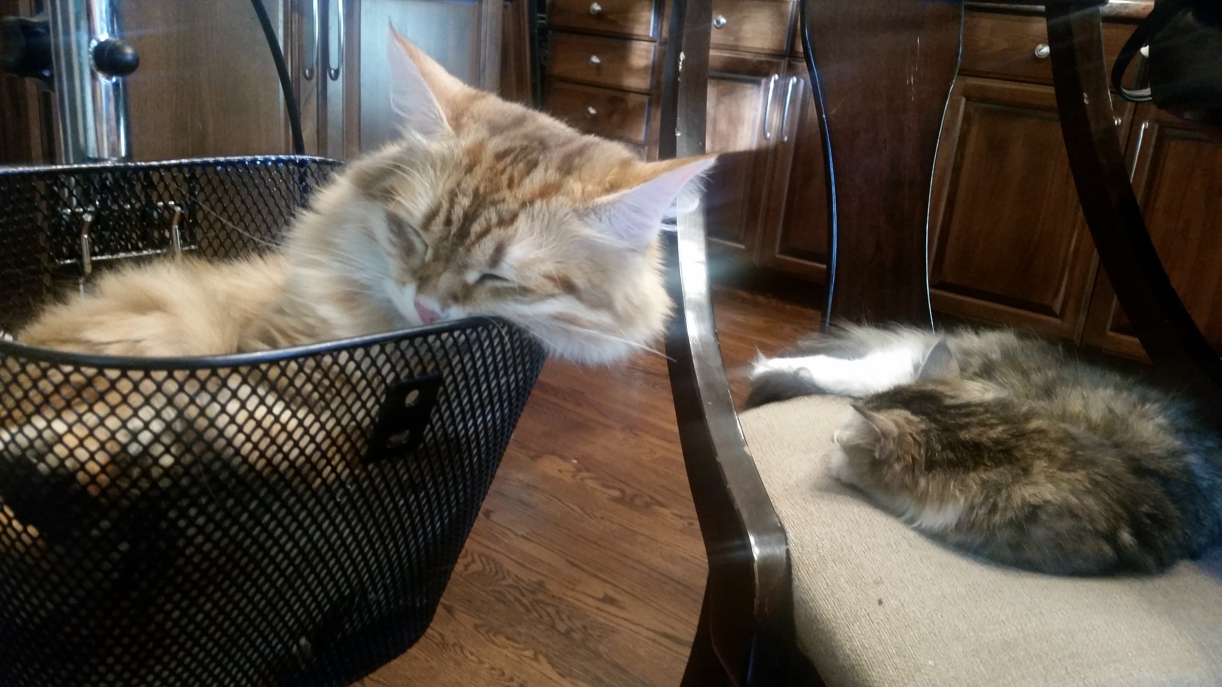

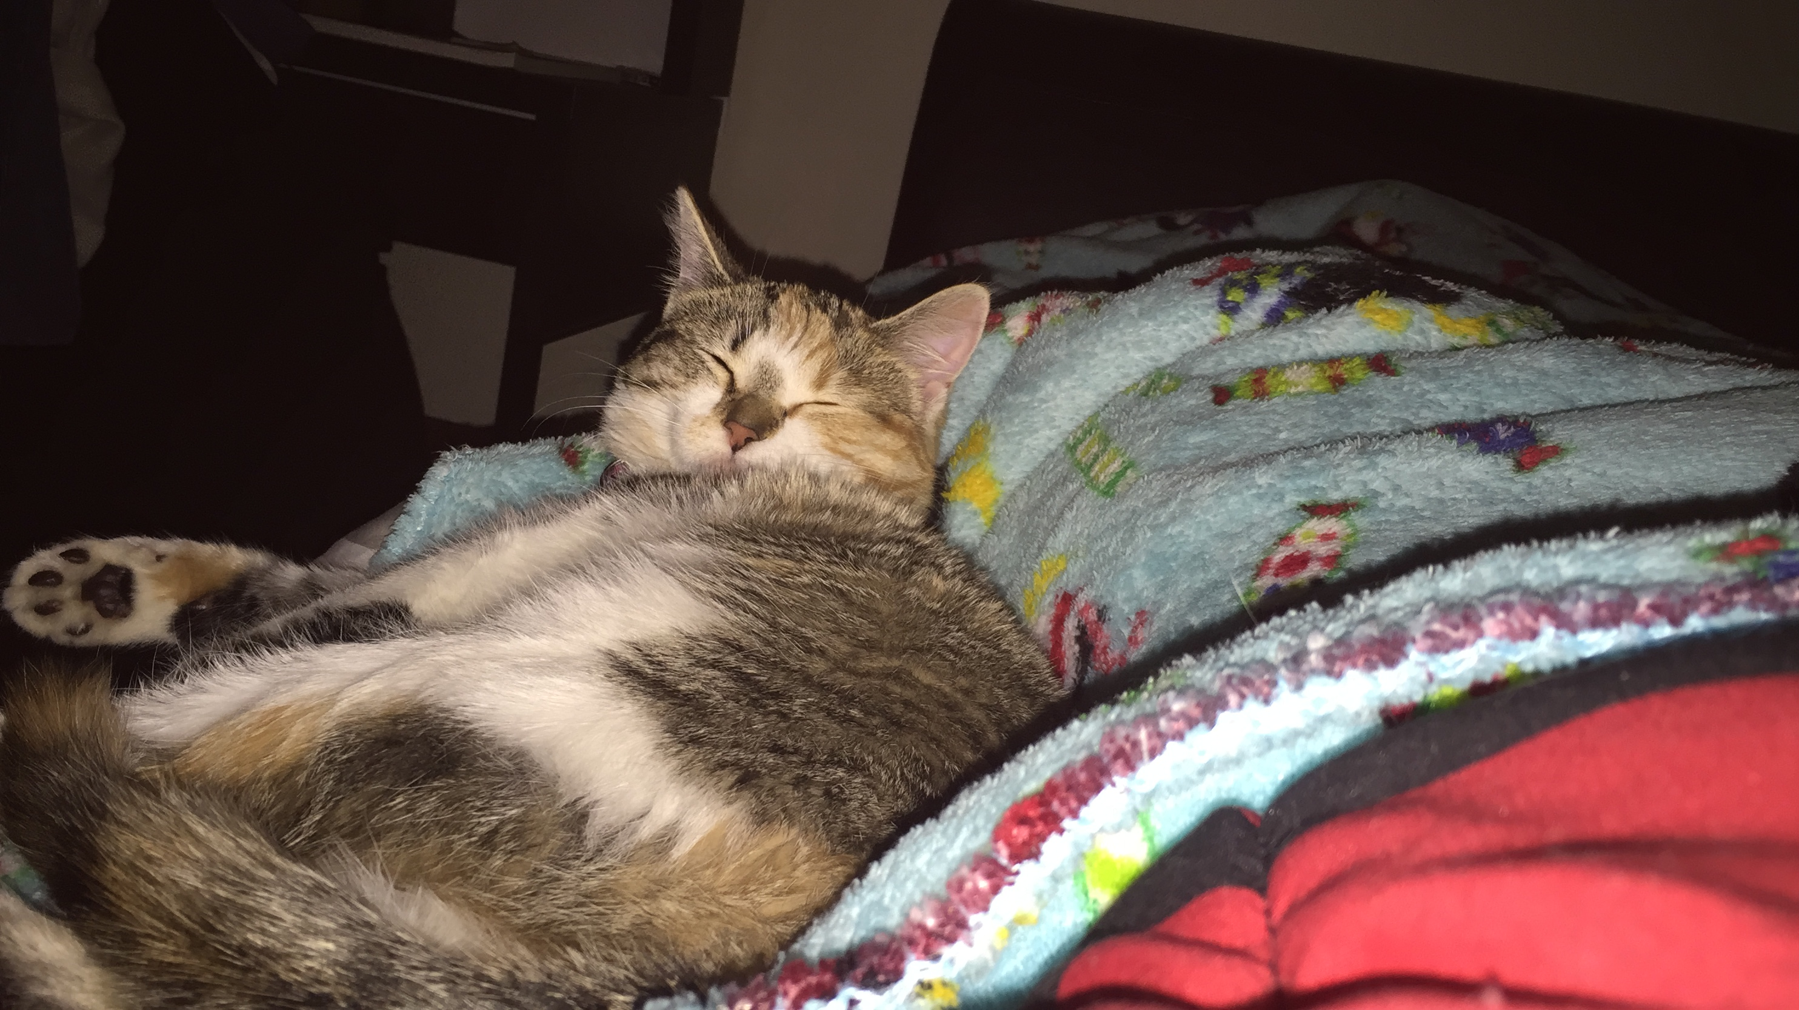
Questions?
Notes:
look cute

